Slide 1

DATA ANALYST CAPSTONE PROJECT
Emerging Technology Trends in the Developer Job Market
Pablo Fiterman
September 1, 2026
IBM Data Analyst Professional Certificate
Stack Overflow Developer Survey · Jobs API · Web-scraped salary data

Slide 2



OUTLINE
Executive Summary
Introduction
Methodology
Results — job market, languages, databases
Dashboard — current usage, future trends, demographics
Discussion
Findings & Implications
Conclusion
Appendix

Slide 3

EXECUTIVE SUMMARY
Three data sources were combined to read the developer job market: 18,845 Stack Overflow survey responses, 27,005 job postings from a Jobs API and scraped salary data for 10 languages.
Demand is concentrated. Three metro areas hold 46.8% of all postings, led by Washington DC with 5,316.
The current stack is stable: JavaScript, SQL and HTML/CSS lead usage, PostgreSQL leads databases, AWS leads platforms.
Intent diverges from usage. Rust (+3.3 pp) and Go (+2.5 pp) gain the most mind-share for next year; JavaScript, PHP and Java lose the most, while still leading in absolute terms.
PostgreSQL is the only database in the current top five that grows in absolute terms (11,514 to 12,193); Redis gains from sixth place.
Pay follows scarcity, not popularity: Swift tops the salary table at $130,801 while the most-used languages sit mid-table.
Compensation correlates only weakly with experience (r = 0.242) and barely at all with satisfaction (r = 0.06); country explains far more.

Slide 4

INTRODUCTION
Purpose, audience and value
Purpose — establish which technologies developers use today, which they intend to adopt next year, and where the job market pays for them.
Audience — hiring managers, L&D leads and technology strategists planning headcount, training budgets and platform bets for the next cycle.
Business questions
Where are the job openings, and for which skills?
Which languages, databases, platforms and frameworks dominate today?
Which are gaining or losing developer mind-share for next year?
Who are the developers behind these answers, and what do they earn?
Value — the current-versus-desired gap is a leading indicator: it flags skills to hire for before the market reprices them.

Slide 5

METHODOLOGY
Data sources
Jobs API (REST/JSON) — 27,005 postings across 13 US metro areas, plus counts per technology.
Web scraping (requests + BeautifulSoup) — annual average salary for 10 popular programming languages.
Stack Overflow Developer Survey — 18,845 responses, 114 columns, 161 countries.
Data wrangling
Duplicates checked and removed; column names normalised.
Missing values treated per column: median for skewed numerics, mode for categoricals, and left blank where over half the column was absent.
Min-max scaling and a log1p transform applied to compensation.
Multi-select answers split on ';' and exploded to one row per selection.
Analysis & tools
Python (pandas, NumPy), SQLite/SQL, Matplotlib & Seaborn, Google Looker Studio for the dashboard.

Slide 6
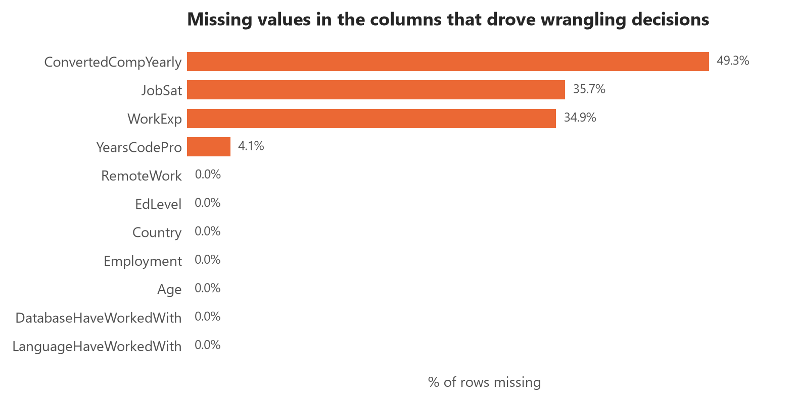
METHODOLOGY — DATA QUALITY & TREATMENT
What the profiling found:
• No duplicate rows and no duplicate ResponseIds remain after the de-duplication step, so the row count is trustworthy.
• ConvertedCompYearly is missing for 49.3% of rows — the single biggest constraint on any pay analysis.
• JobSat (35.7%) and WorkExp (34.9%) are also heavily incomplete.
How it was handled:
• Compensation was left unimputed for distribution and correlation work and reported on its valid subset (9,550 responses) — imputing half a column with its own median would manufacture a false peak.
• Outliers were bounded with the 1.5 × IQR rule; 346 values (3.6%) fall above $226,667 and are excluded from pay comparisons, not deleted from the dataset.
Every count on the following slides therefore states its own denominator.

Slide 7

RESULTS
Job postings by location
Popular languages by salary
Programming language trends
Database trends
Job market · Programming languages · Databases

Slide 8
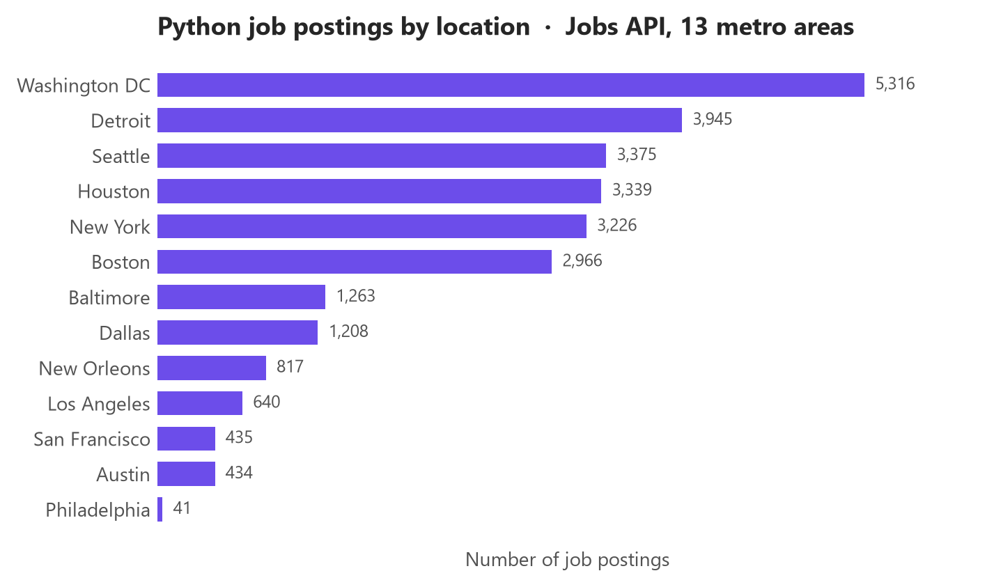
JOB POSTINGS
27,005 Python postings across 13 metro areas
Washington DC leads with 5,316 postings — 19.7% of the total.
The top three metros hold 46.8% of all postings; demand is geographically concentrated rather than evenly spread.
The tail is very thin: Philadelphia returns only 41 postings, a 130× gap to the leader.
Read as relative demand, not absolute market size — the API returns postings indexed at collection time, not a census of open roles.

Slide 9
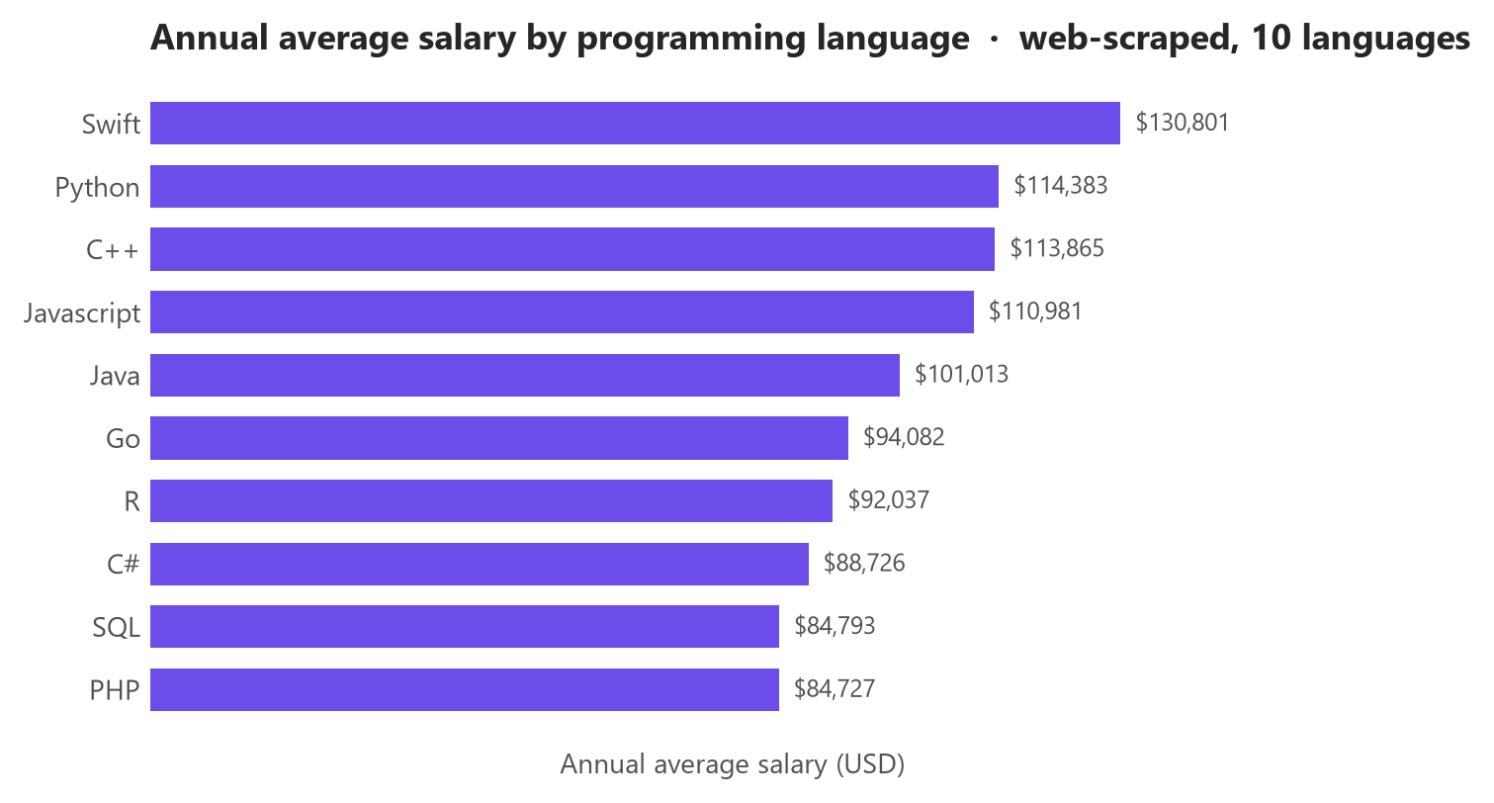
POPULAR LANGUAGES
Salary rewards scarcity, not ubiquity
Swift pays the most at $130,801, ahead of Python ($114,383) and C++.
PHP sits last at $84,727 — a $46,074 spread across the ten languages (mean $101,540).
The most widely used languages are not the best paid: JavaScript and SQL dominate survey usage yet sit in the lower half of this table.
Implication — specialising in a narrower, in-demand language is better compensated than adding another mainstream one.

Slide 10
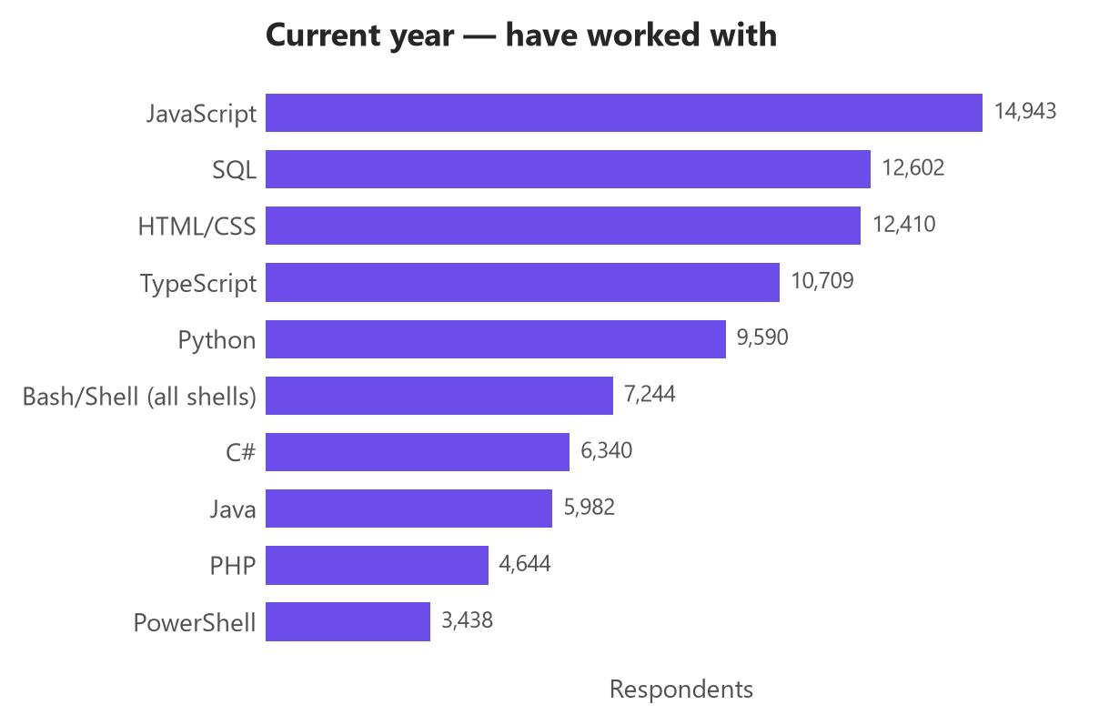
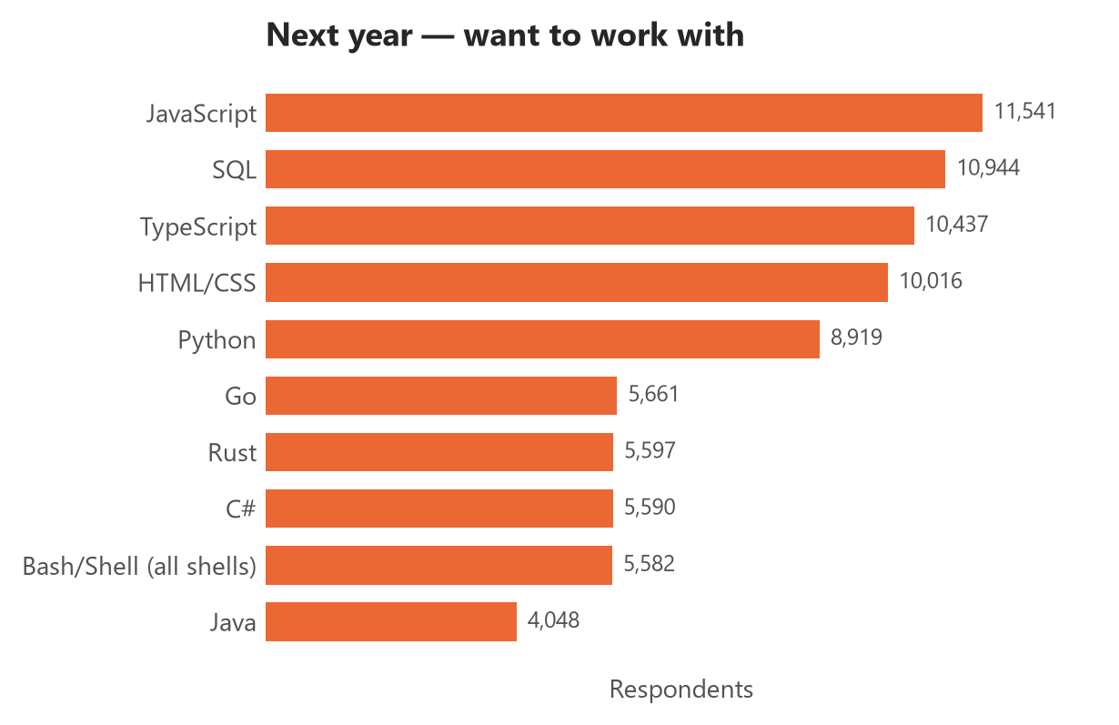
PROGRAMMING LANGUAGE TRENDS
The top five are unchanged in composition, but four of them lose share while TypeScript gains and climbs past HTML/CSS; Go and Rust break into the top ten.
Current Year
Next Year

Slide 11
PROGRAMMING LANGUAGE TRENDS - FINDINGS & IMPLICATIONS
Findings
JavaScript leads both years but loses the most share of any language (-2.0 pp).
Rust is the biggest gainer at +3.3 pp, followed by Go at +2.5 pp.
TypeScript is the only current top-four language that gains share (+0.6 pp), overtaking HTML/CSS for next year.
PHP (-1.4 pp) and Java (-1.3 pp) fall furthest after JavaScript.
Respondents list fewer languages they want (5.64 on average) than they already use (6.19) — intent is narrower than practice.
Implications
Keep hiring for the incumbents — JavaScript, SQL and TypeScript remain the baseline, and losing share is not the same as losing volume.
Treat Rust and Go as a build-ahead investment: demand for them is being created by developer preference before the job market reprices it.
Fund TypeScript training explicitly; it is the only mainstream language gaining share and it consolidates the JavaScript ecosystem.
Plan PHP and Java estates as maintenance, not growth — expect a shrinking and more expensive hiring pool over time.
Because intent lists are shorter than usage lists, read these as changes in priority, not as forecasts of abandonment.

Slide 12
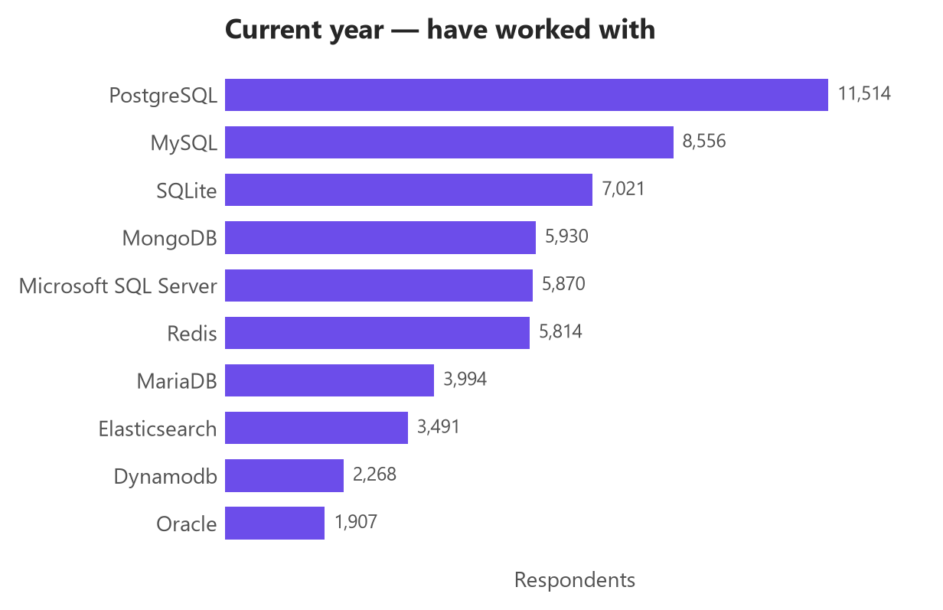
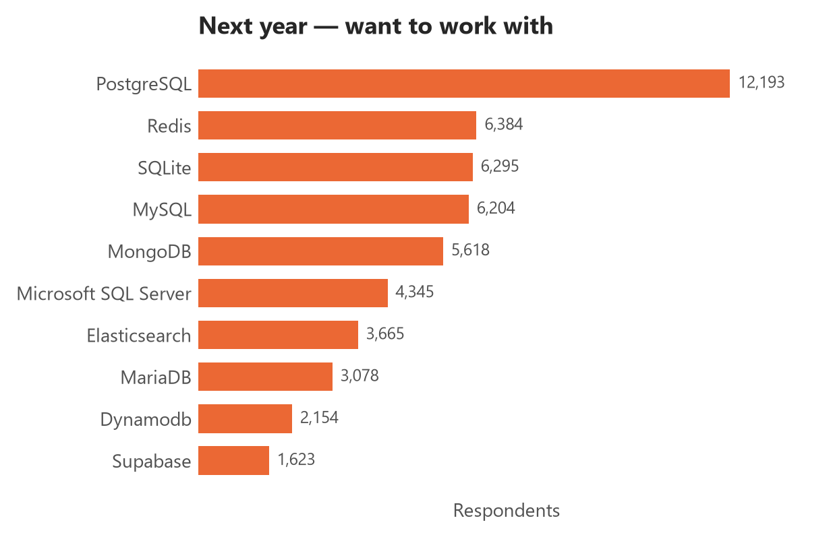
DATABASE TRENDS
PostgreSQL extends its lead and is the only database in the current top five to grow; Redis jumps from sixth to second while MySQL drops to fourth.
Current Year
Next Year

Slide 13
DATABASE TRENDS - FINDINGS & IMPLICATIONS
Findings
PostgreSQL leads both years and grows in absolute terms — 11,514 current users versus 12,193 intending to use it next year (+2.0 pp share).
MySQL is the largest loser at -2.9 pp, falling from second place to fourth.
Redis gains +1.3 pp and moves from sixth to second — caching and in-memory workloads are becoming default.
Supabase enters the top ten (+0.8 pp) with no comparable current-usage footprint.
Commercial engines decline: Microsoft SQL Server -1.8 pp and Oracle -1.1 pp.
Implications
Standardise new services on PostgreSQL — it is the only clear consolidation point, which lowers both hiring and operating risk.
Budget for Redis as core infrastructure rather than an optimisation, and hire for cache-aware design.
Plan MySQL, SQL Server and Oracle estates for migration or long-term maintenance; the skills pool is drifting away from them.
Watch Supabase and BigQuery as managed-service entrants: developer interest arrives before enterprise adoption.
Interest is not deployment — validate these signals against your own workload, licensing and data-residency constraints before committing.

Slide 14

DASHBOARD
Three tabs built on the survey extract
Tab 1 — Current technology usage: top 10 languages, databases, platforms and web frameworks.
Tab 2 — Future technology trends: the same four dimensions for next year.
Tab 3 — Demographics: respondents by country, age group and education level.
Source: one extract of 18,845 survey responses, with each multi-select field normalised to one row per selection.

Slide 15
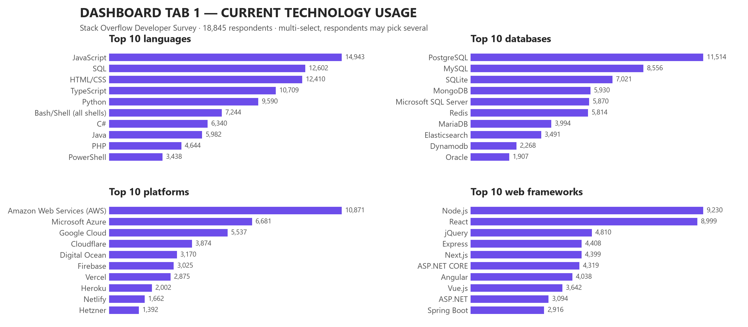
DASHBOARD TAB 1: Current Technology Usage
Dashboard insight — the working stack is web-first and cloud-centred
• JavaScript (14,943), SQL (12,602) and HTML/CSS (12,410) are used by the largest share of respondents; TypeScript is already fourth.
• PostgreSQL (11,514) is the most-used database, ahead of MySQL (8,556); SQLite third place reflects embedded and local development.
• AWS (10,871) is used by more respondents than Azure (6,681) and Google Cloud (5,537) individually, and nearly as many as the two combined.
• Node.js (9,230) and React (8,999) dominate frameworks, but jQuery is still third (4,810) — a large legacy estate is still in production.

Slide 16
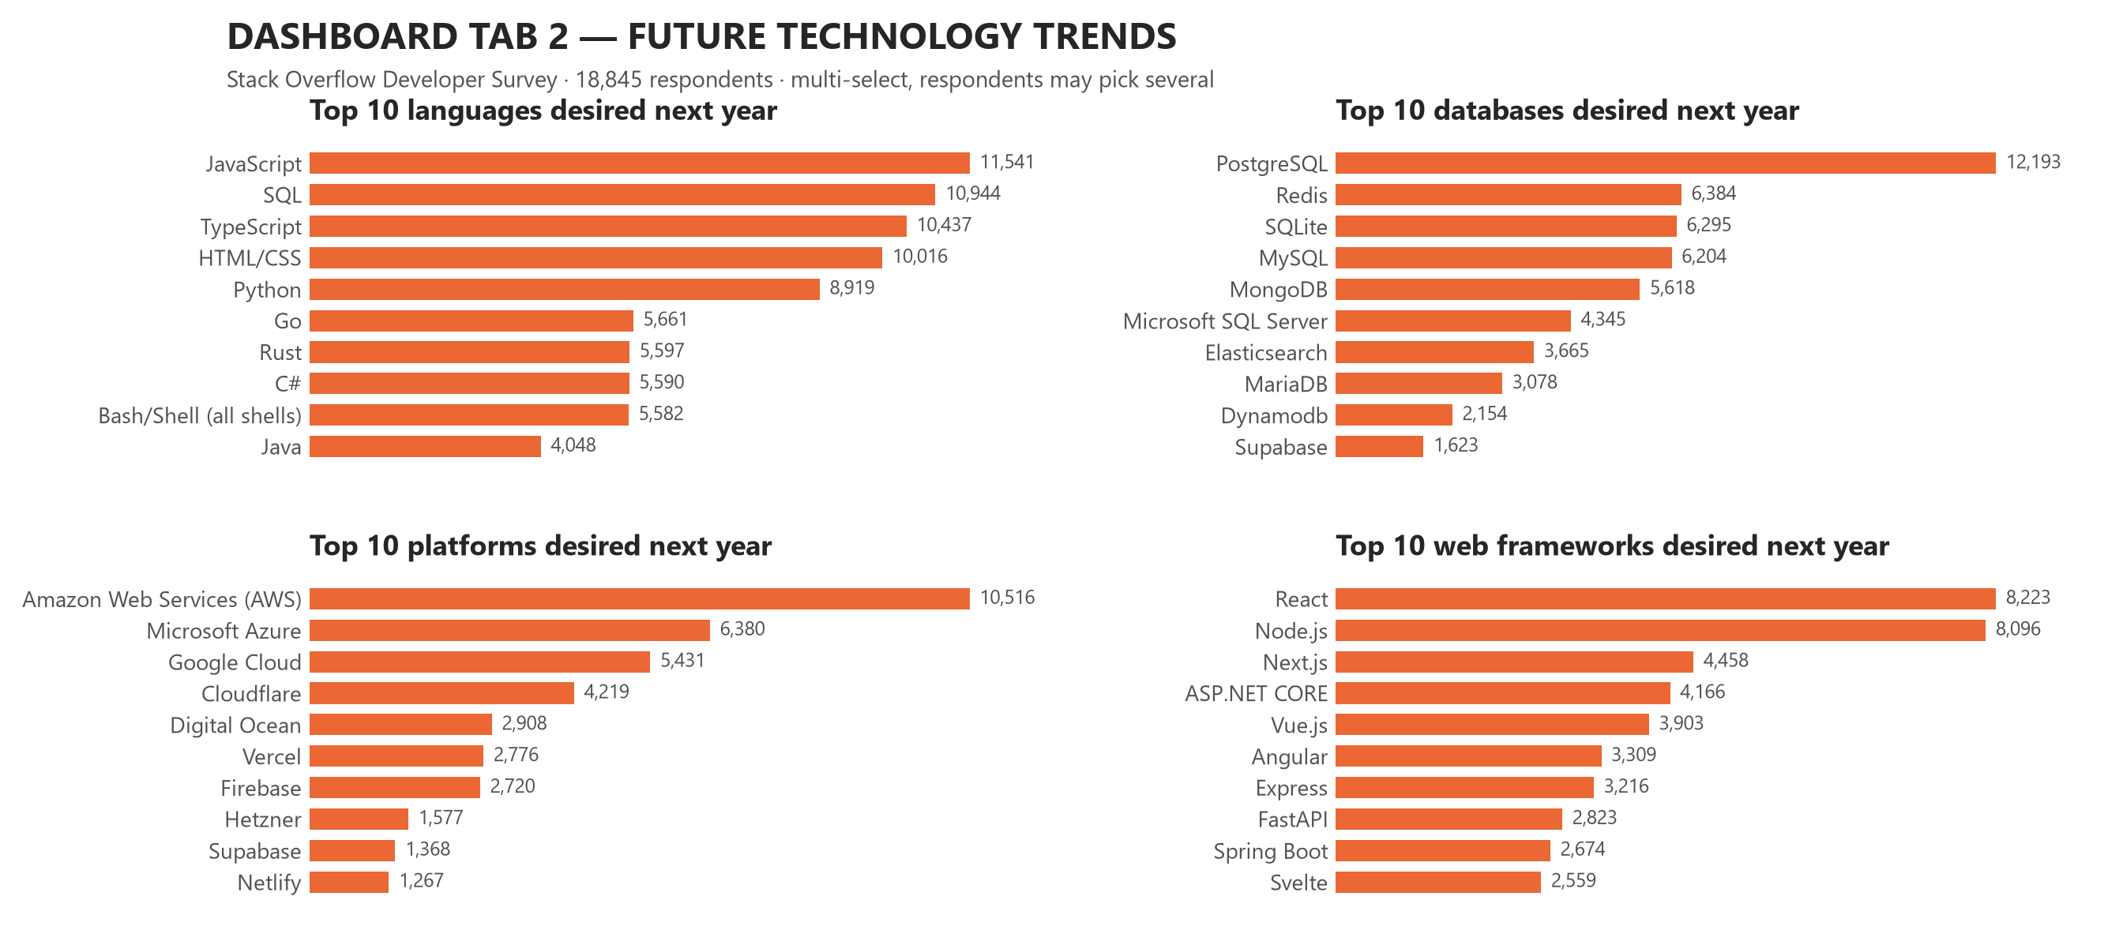
DASHBOARD TAB 2: Future Technology Trends
Dashboard insight — intent shifts toward typed, systems and managed tools
• The language leaders hold their ranks, but Go (5,661) and Rust (5,597) enter the top ten at sixth and seventh, and TypeScript overtakes HTML/CSS for third.
• PostgreSQL grows to 12,193 and Redis rises to second (6,384); MySQL falls to fourth.
• The cloud hierarchy is stable — AWS, Azure, Google Cloud — but Cloudflare gains (3,874 → 4,219) and Heroku drops out of the top ten.
• React overtakes Node.js in frameworks and Next.js moves to third, while jQuery — currently third by usage — drops out of the desired top ten.

Slide 17
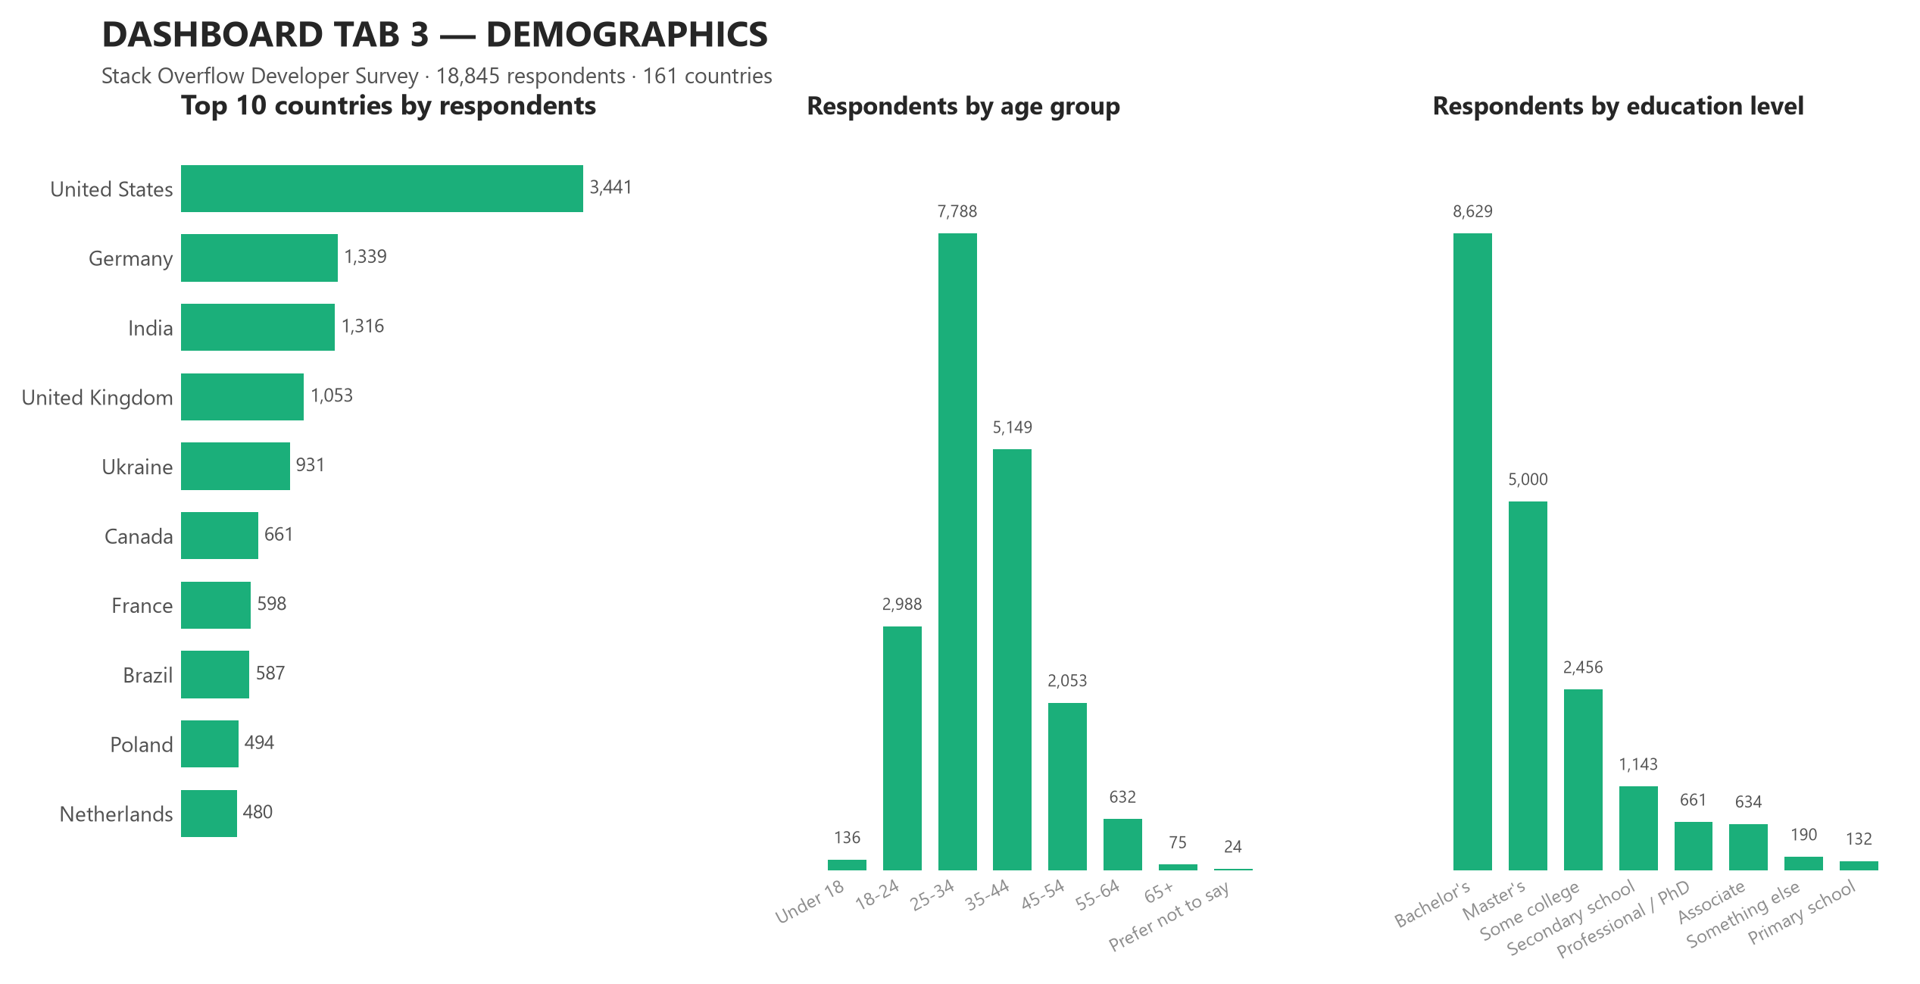
DASHBOARD TAB 3: Demographics
Dashboard insight — a young, formally educated, Western-weighted sample
• The top five countries supply 42.9% of all responses, led by the United States (3,441); 161 countries appear in total.
• The 25–34 bracket alone is 41.3% of respondents and 57.9% are under 35 — the sample skews early-career.
• 79.2% hold a tertiary degree, with Bachelor's the single largest group (8,629 respondents).
• Caveat — this is a self-selected sample of Stack Overflow users, so it over-represents English-speaking, web-focused developers. Every trend above should be read as this population's direction of travel, not the whole industry's.

Slide 18
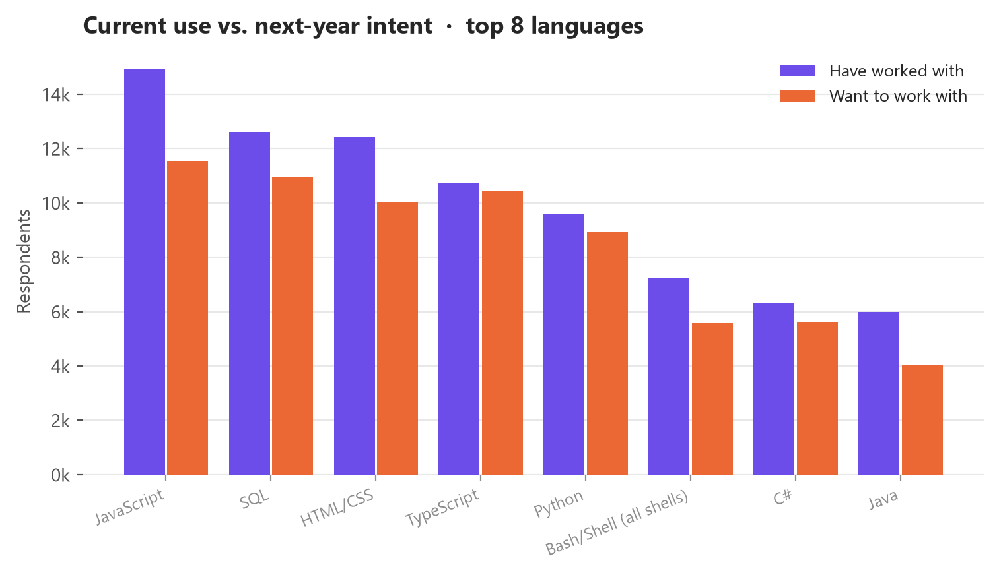
DISCUSSION
What the three tabs say together
Continuity, not disruption. The same technologies lead current usage and next-year intent; what changes is the ordering and the size of the gaps.
Almost every incumbent loses share, partly because respondents name fewer technologies they want than they already use. Comparing shares rather than raw counts is what separates a real shift from that arithmetic.
Consolidation is the dominant pattern: PostgreSQL in databases, TypeScript in languages, React/Next.js in frameworks, AWS in platforms.
The market and the developers disagree. Job postings cluster on Java and JavaScript, pay peaks on Swift, and usage peaks on JavaScript — popularity, hiring demand and salary are three different rankings.
Demographics bound every claim: a young, degree-holding, US-and-Europe-weighted, self-selected sample.

Slide 19
OVERALL FINDINGS & IMPLICATIONS
Findings
Job demand is concentrated: 46.8% of 27,005 postings sit in three metro areas.
Hiring demand does not track developer usage: Java (3,428 postings) and JavaScript (2,248) outrank Python (1,173). The C total (25,114) is treated as unreliable — see A3.
Pay is led by Swift ($130,801) — a $46,074 spread over ten languages.
PostgreSQL, TypeScript, Rust, Go and Redis gain share; MySQL, PHP, Java, SQL Server and jQuery lose it.
Location beats experience on pay: median compensation runs $148,000 in the United States against $19,142 in India, while experience correlates only r = 0.242.
Satisfaction is high (71.4% score 7+) and effectively uncorrelated with pay (r = 0.06).
43.4% work fully remotely and 41.5% hybrid — only 15.2% are fully in-person.
Implications
Recruit where the postings are, but source talent remotely — 85% of respondents already work remote or hybrid, so the concentration of postings need not constrain the hiring pool.
Separate the three signals when planning: what developers use, what employers post for, and what the market pays are different rankings and should drive different decisions.
Standardise on the consolidation winners (PostgreSQL, TypeScript, React/Next.js, AWS) to reduce long-run hiring risk.
Fund Rust and Go upskilling now, while interest exceeds supply and before salaries reprice.
Do not use pay as a retention lever on its own — the pay/satisfaction correlation is near zero, so flexibility and role design matter more.
Set compensation bands by market geography rather than by seniority alone.
Re-run this analysis each survey cycle: a single year shows a gap, a sequence of years shows a trend.

Slide 20
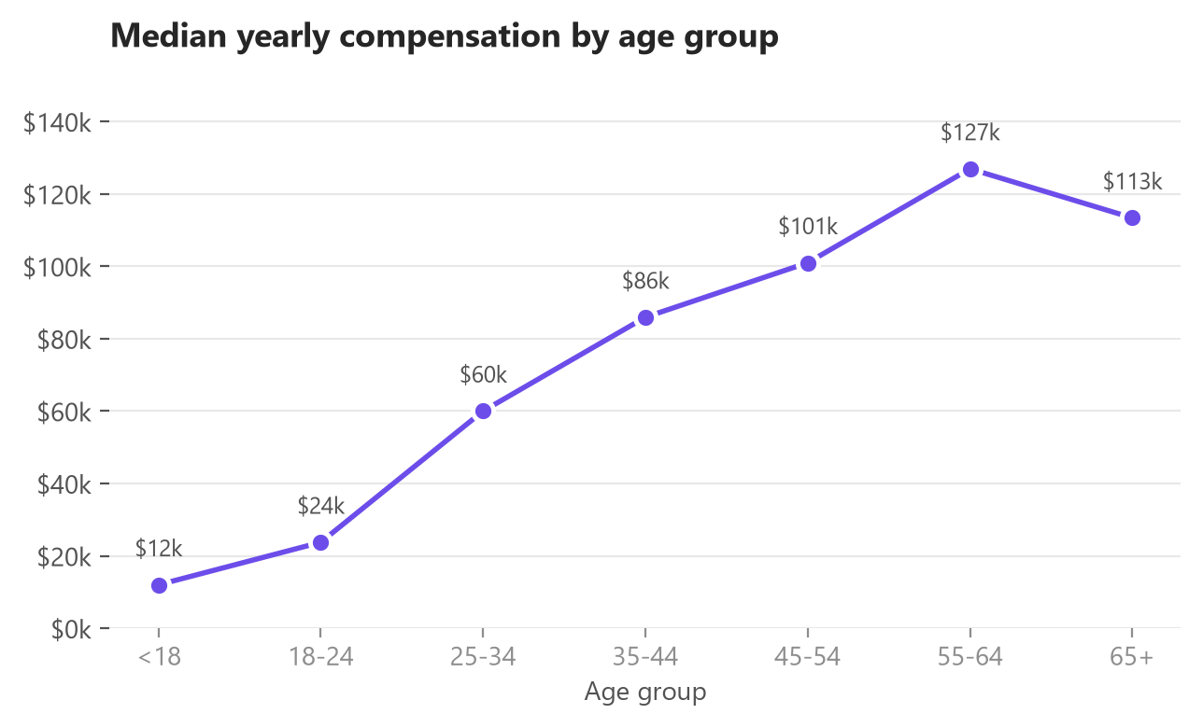

CONCLUSION
The developer technology landscape is consolidating, not fragmenting. The leaders of today are the leaders of next year; the movement is in how much share each holds.
Three independent rankings drive different decisions. Usage (survey), hiring demand (job postings) and pay (salary data) disagree — planning on any one of them alone is a mistake.
The current-versus-desired gap is the most actionable output. Rust, Go, TypeScript, PostgreSQL and Redis gain share; PHP, Java, MySQL and legacy commercial engines lose it. That gap is the training and hiring agenda.
Geography, not seniority, is the largest measurable driver of pay in this dataset, and pay is a weak lever on satisfaction.
Limitations — a self-selected sample, roughly half of compensation values missing, one survey year with no time series, and stated intent rather than observed adoption. Conclusions are directional.
Next steps — repeat across survey years to convert gaps into trends, join to a larger postings dataset for demand validation, and segment by role and region before acting.

Slide 21

APPENDIX
Additional charts and tables produced during the analysis phase
A1 — Net mind-share shift by programming language
A2 — Net mind-share shift by database
A3 — Job postings by required technology
A4 — Compensation distribution, raw and log-transformed
A5 — Compensation by country
A6 — Correlation matrix of pay, experience and satisfaction
A7 — Job satisfaction distribution
A8 — Language adoption by country
A9 — Work arrangement and desired databases
A10 — Dataset and methodology reference

Slide 22
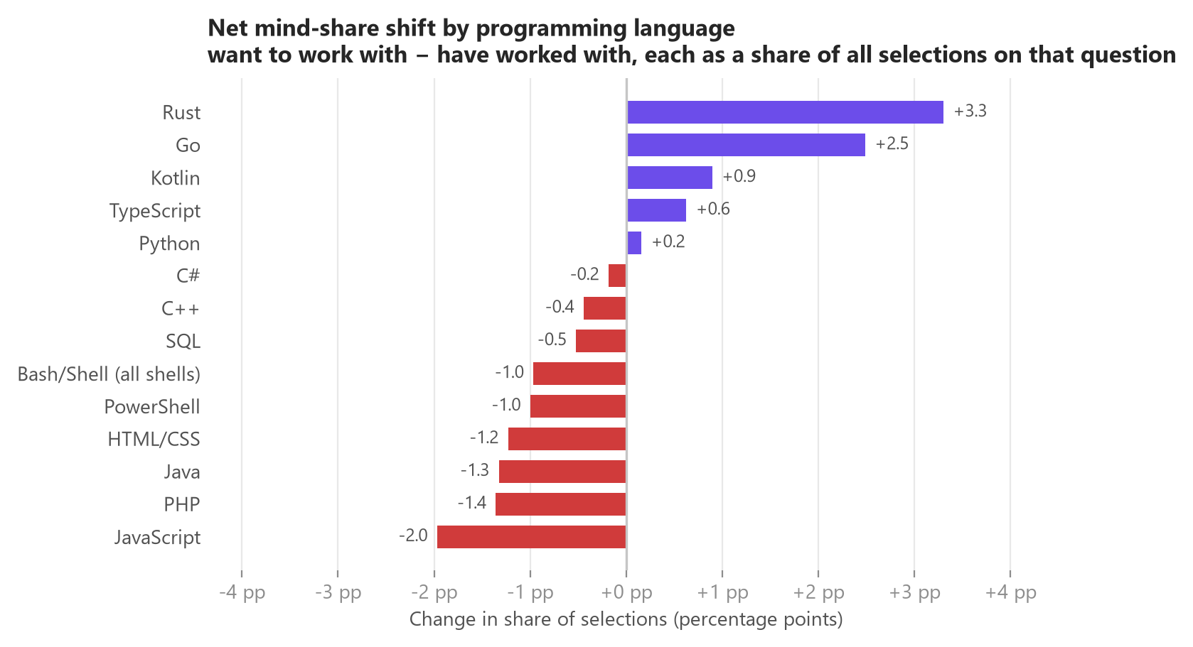
A1 — NET MIND-SHARE SHIFT BY PROGRAMMING LANGUAGE
Each side is expressed as a share of all selections made on its own question, because respondents name 6.19 languages they have used but only 5.64 they want. Subtracting raw counts would push every language negative; comparing shares isolates the genuine change in priority.

Slide 23
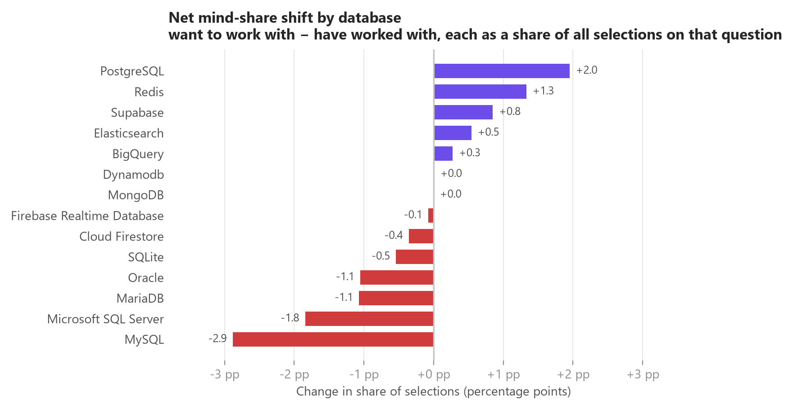
A2 — NET MIND-SHARE SHIFT BY DATABASE
Same share-based normalisation as A1 (3.69 databases used vs 3.5 wanted per respondent). PostgreSQL and Redis are the only large gainers; MySQL, SQL Server, MariaDB and Oracle all decline.

Slide 24
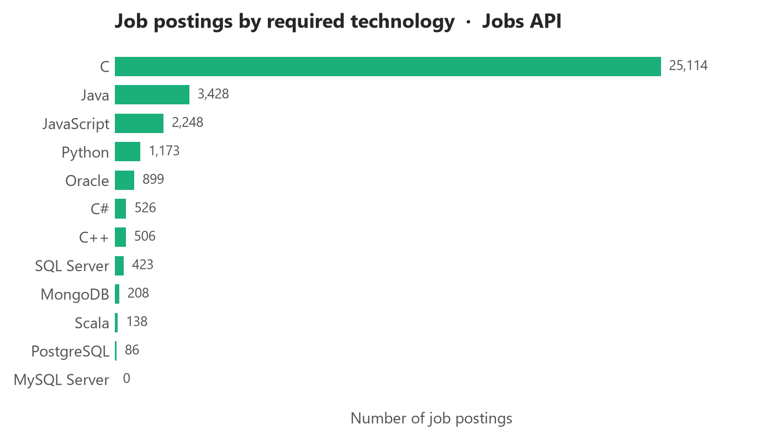
A3 — JOB POSTINGS BY REQUIRED TECHNOLOGY
C dominates at 25,114 postings, far ahead of Java (3,428) and JavaScript (2,248). The 'C' count is almost certainly inflated by substring matching on job text, which is why hiring-demand conclusions in this report lean on the per-location data rather than this breakdown.

Slide 25
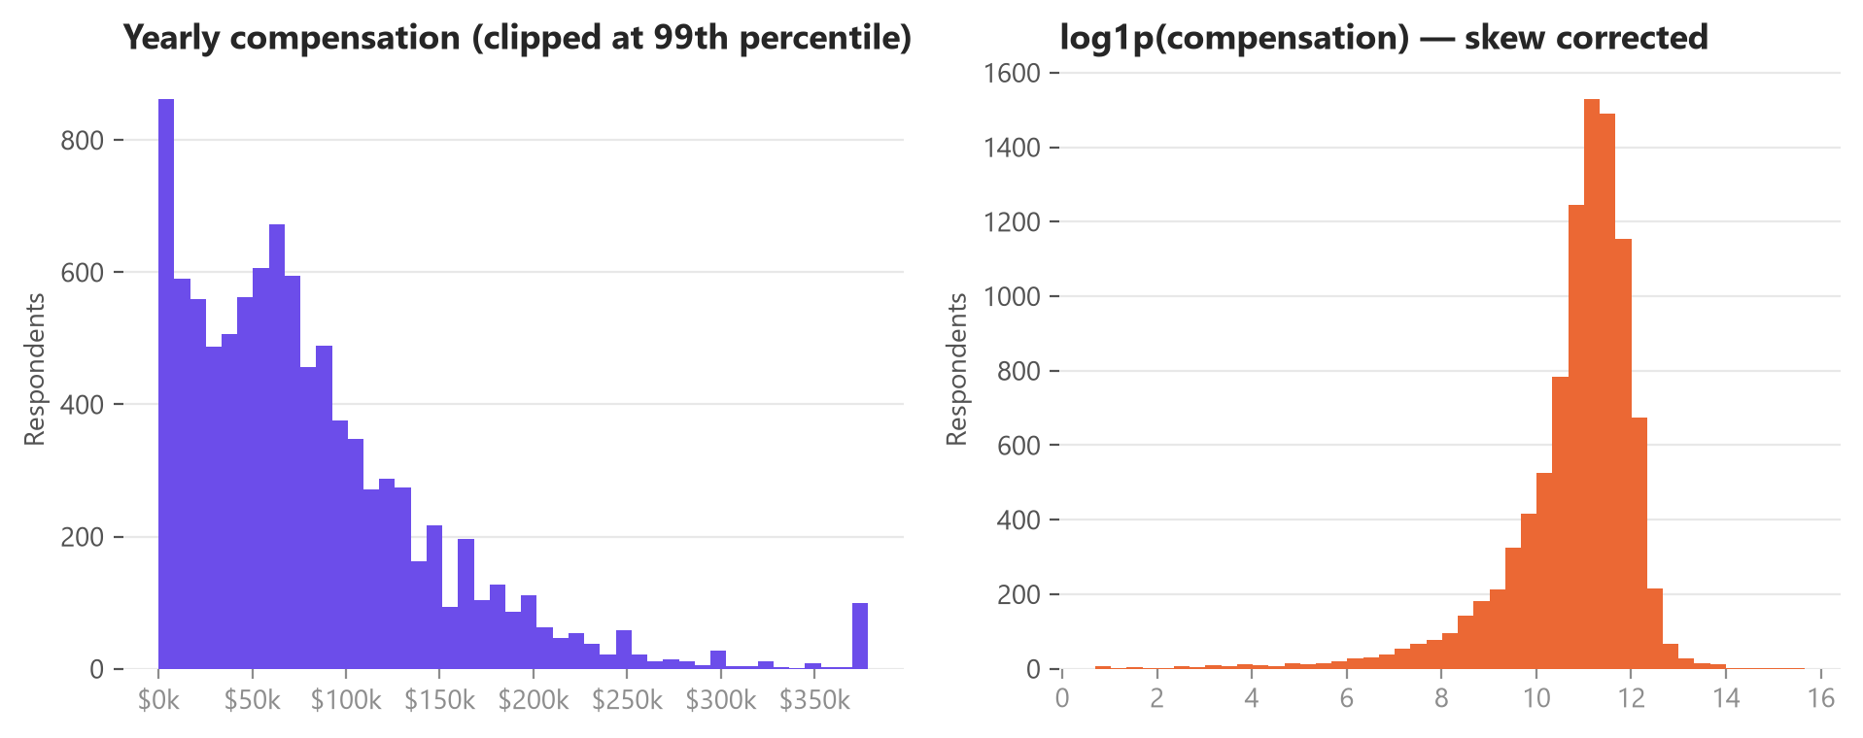
A4 — COMPENSATION DISTRIBUTION
Median $65,857 against a mean of $84,589 on 9,550 valid responses — a strong right skew. The log1p transform on the right makes the distribution usable for correlation work; the left panel is clipped at the 99th percentile for readability.

Slide 26
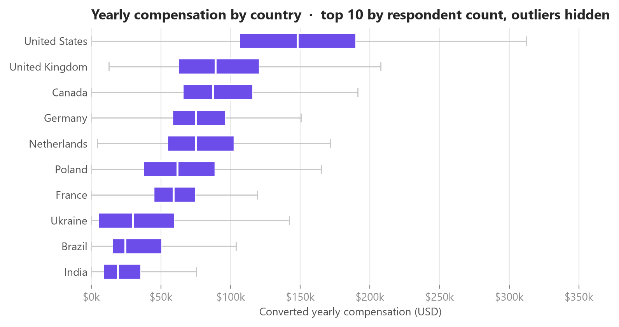
A5 — COMPENSATION BY COUNTRY
Median pay ranges from $148,000 in the United States to $19,142 in India — a 7.7× spread that dwarfs the effect of experience. Outliers are hidden and the axis is capped at the 98.5th percentile.

Slide 27
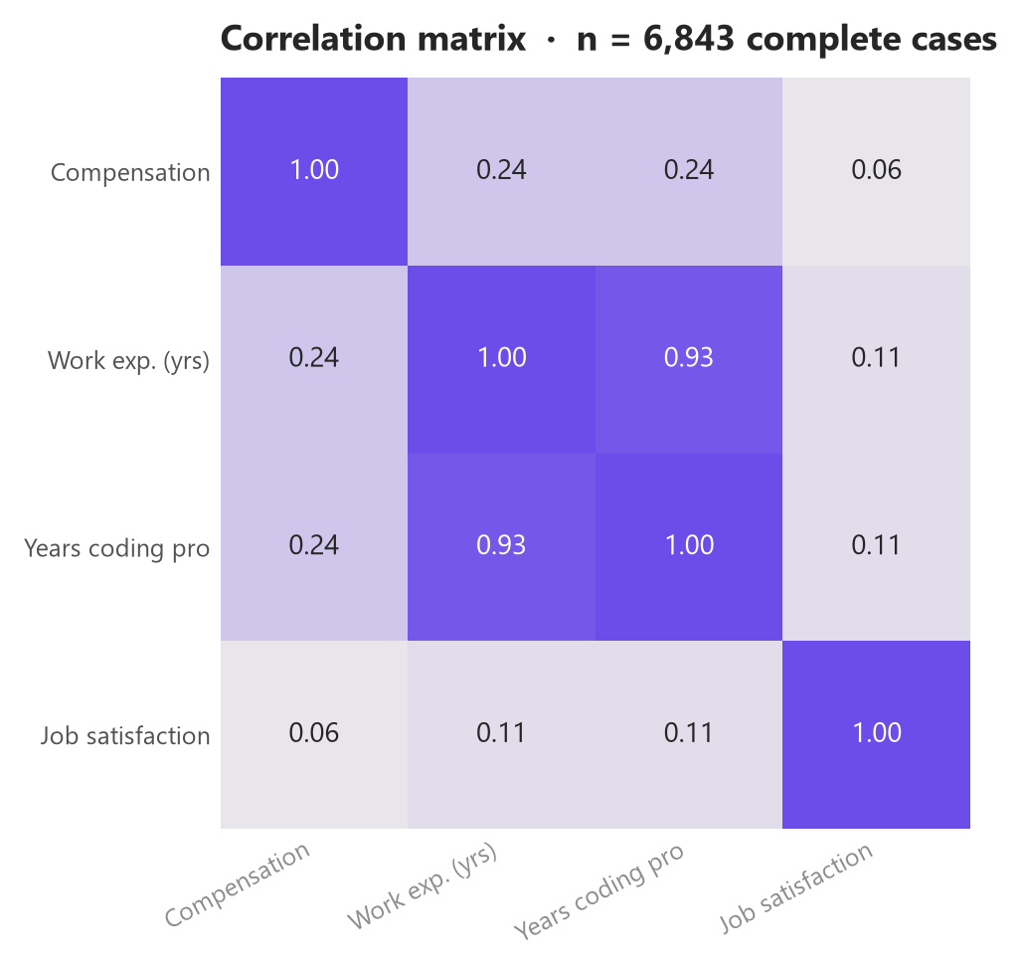
A6 — CORRELATION MATRIX
On 6,843 complete cases: compensation correlates weakly with work experience (r = 0.242) and professional coding years (r = 0.245); job satisfaction is essentially independent of both pay (r = 0.06) and experience (r = 0.107). Listwise deletion means this subset over-represents respondents who answered the pay question.

Slide 28
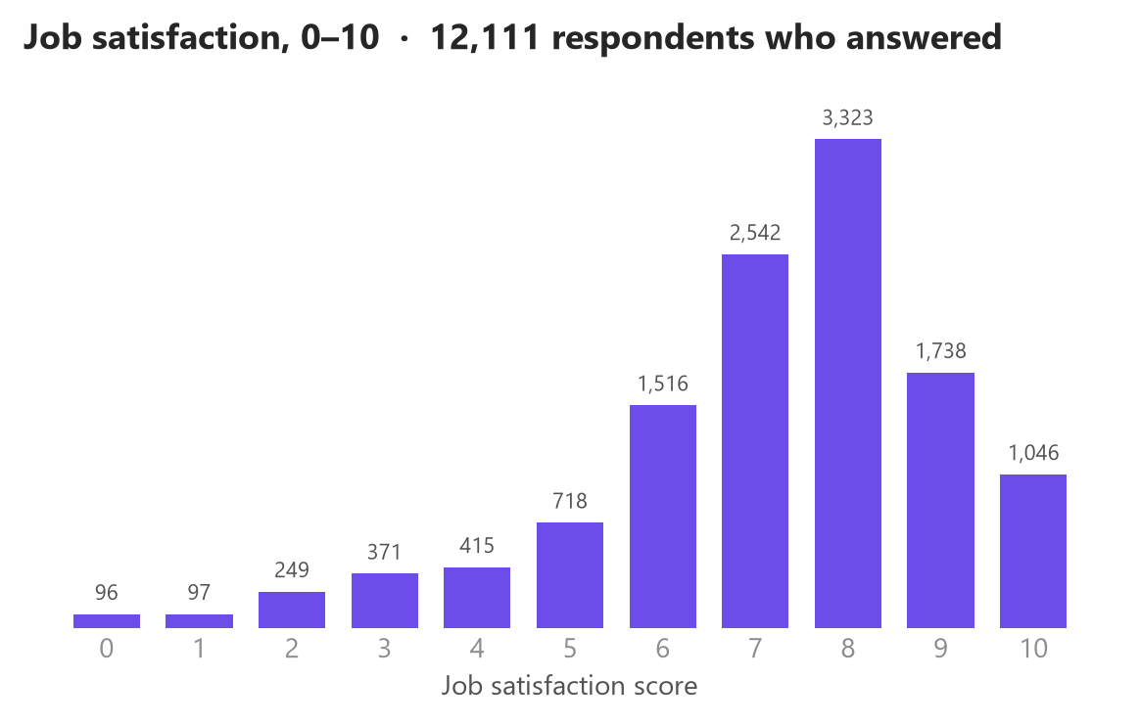
A7 — JOB SATISFACTION DISTRIBUTION
12,111 respondents answered (35.7% did not). The distribution is left-skewed toward high scores: median 8, mean 7.15, and 71.4% scoring 7 or above. The non-response rate is high enough that this should be read as the view of respondents who chose to answer.

Slide 29
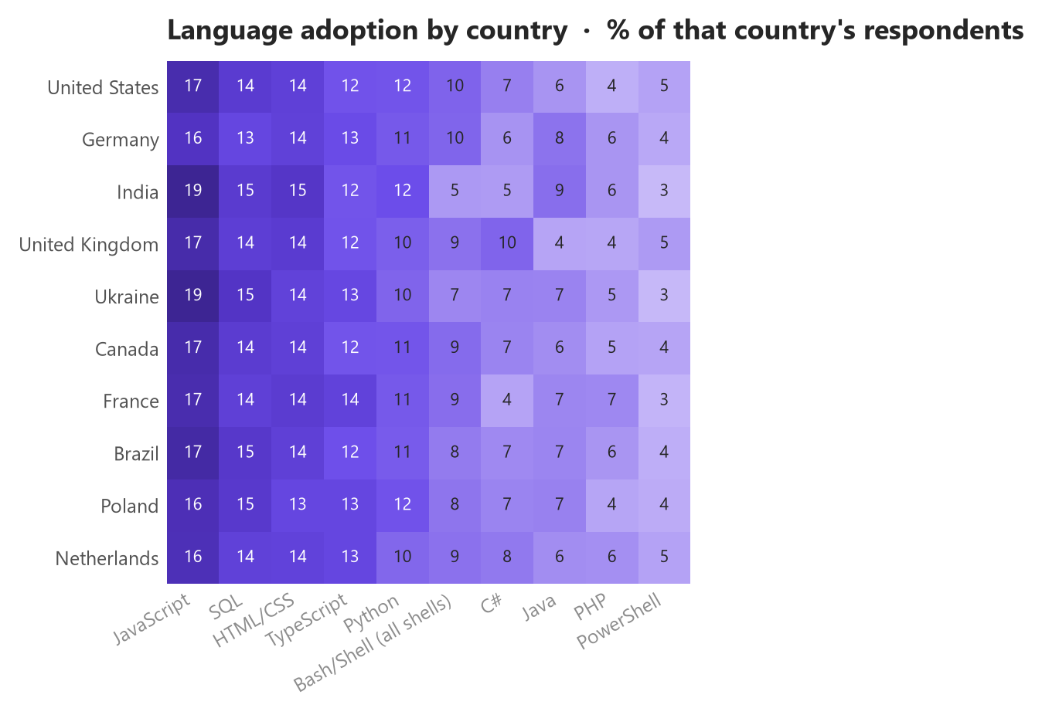
A8 — LANGUAGE ADOPTION BY COUNTRY
Each cell is the percentage of that country's respondents who report using the language, so rows are comparable despite very different sample sizes. The top ten languages are near-universal across all ten countries — regional variation is much smaller than the overall usage differences between languages.

Slide 30
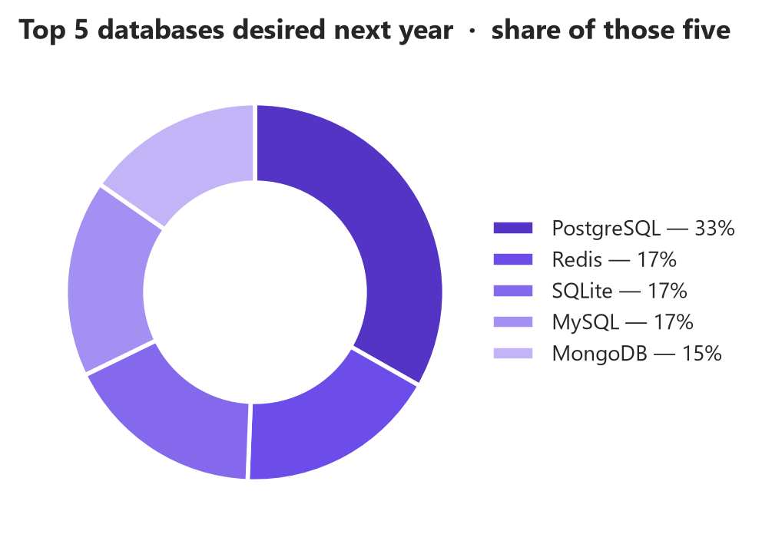
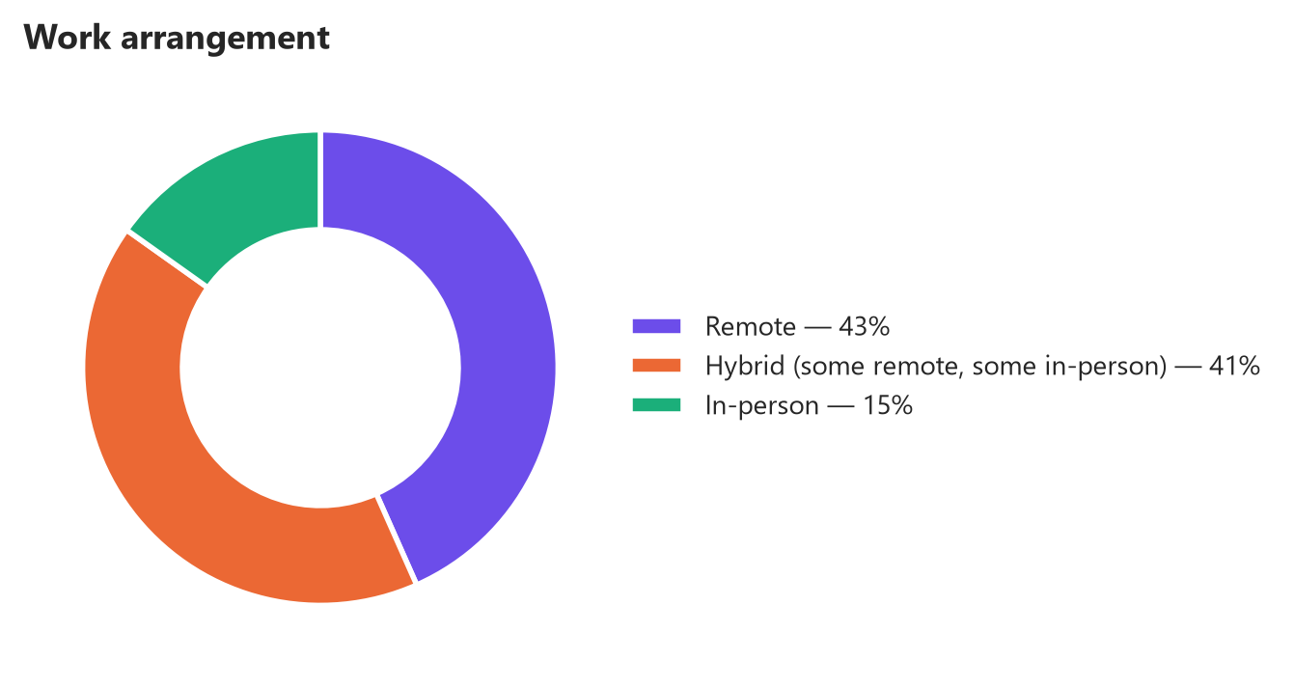
A9 — WORK ARRANGEMENT AND DESIRED DATABASES
Left: only 15.2% of respondents work fully in-person; 43.4% are fully remote and 41.5% hybrid, which is why the geographic concentration of job postings need not constrain the hiring pool. Right: composition of the top five databases respondents want next year — PostgreSQL alone is roughly as large as the next two combined.

Slide 31
A10 — DATASET AND METHODOLOGY REFERENCE
Item | Detail
Primary dataset | Stack Overflow Developer Survey extract — 18,845 rows × 114 columns, 161 countries
Secondary datasets | Jobs API postings (27,005 across 13 metros; plus a per-technology breakdown) and web-scraped salaries for 10 languages
Multi-select fields | LanguageHaveWorkedWith / WantToWorkWith, Database…, Platform…, Webframe… — split on ';' and exploded to one row per selection
Selections per respondent | Languages 6.19 used vs 5.64 wanted; databases 3.69 vs 3.5
Compensation coverage | 9,550 valid values (49.3% missing); median $65,857, mean $84,589
Outlier rule | 1.5 × IQR; upper bound $226,667, 346 values (3.6%) excluded from pay comparisons
Duplicates | 0 duplicate rows, 0 duplicate ResponseIds
Tools | Python (pandas, NumPy), SQLite/SQL, Matplotlib, Seaborn, BeautifulSoup, Google Looker Studio
Chart colour | Palette validated for colour-vision deficiency: purple = current year, orange = next year, teal = demographics, red = negative change
Key caveat | Self-selected sample; stated intent, not observed adoption; a single survey year with no time series

